Slide 1
HeyMath! User Guide - Teachers

Slide 2
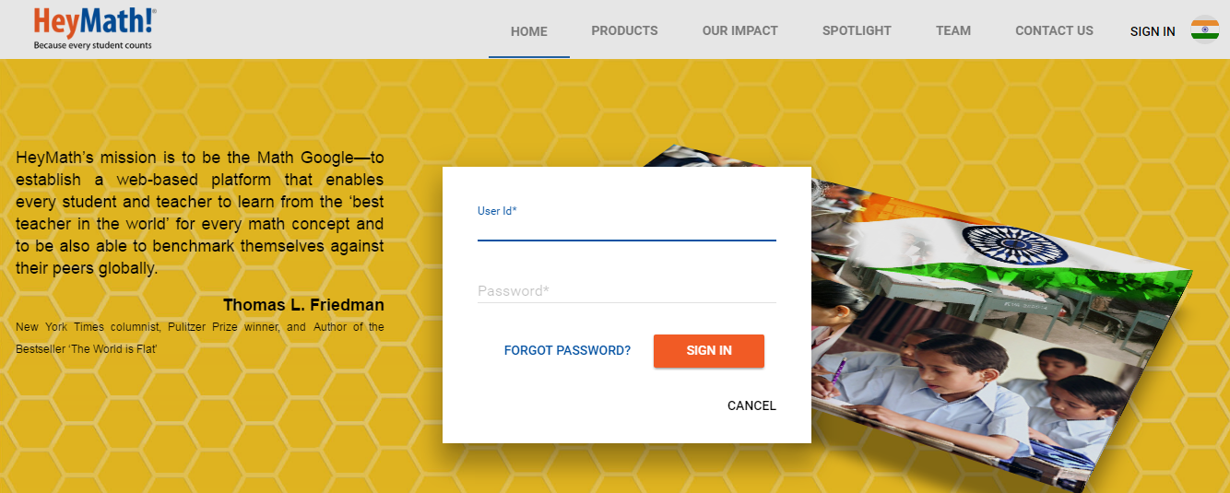
Logging into HeyMath!
Click on SIGN IN to enter your User ID and Password
Enter the HeyMath! User ID & Password
After logging in, you will see the Dashboard

Slide 3
HeyMath! Dashboard
On signing in, you will land on the Dashboard
Other menus
You can see your quick usage here
Assignments that are currently in progress for students are shown here. Teachers can easily track submissions and click here to view reports
Your assignments still under creation are listed here for quick access
Calendar gives a snapshot of assignments that are in progress to help teachers plan their schedule

Slide 4
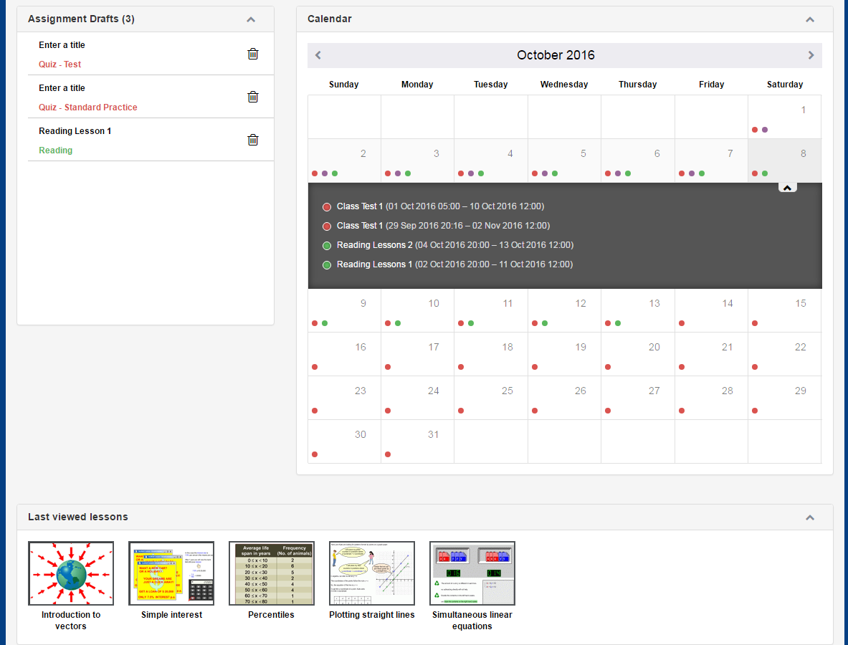
HeyMath! Dashboard
Click on the pointers to view the assignment details
Last viewed lessons are shown here which serve as a bookmark

Slide 5
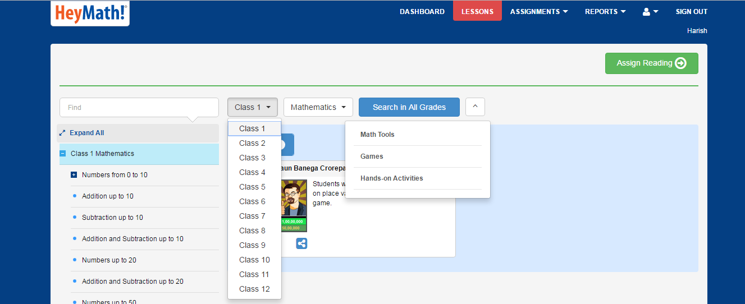
HeyMath! Lessons
Click on LESSONS to view the lessons mapped to your curriculum
Type a keyword to search for lessons across grades
Select the Subject from the dropdown
Select the Level from the dropdown
Lesson resources filtered by type (For example, Math Tools) can be accessed from here

Slide 6
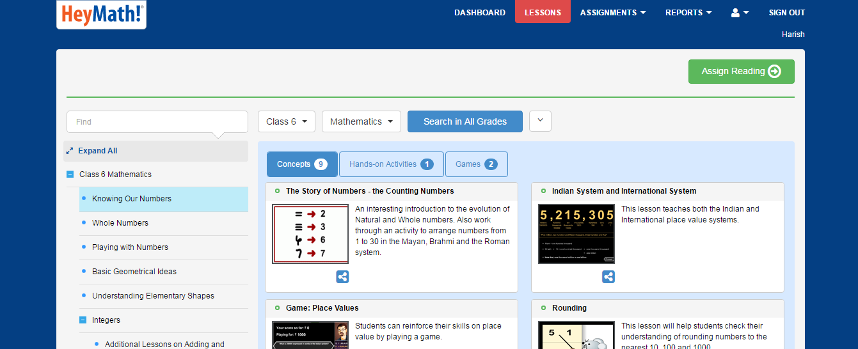
HeyMath! Lessons
Access lesson resources categorised by type: Concept based lessons, Hand-On Activities, Math Tools, Games, resources etc. within each Topic
Choose this if you wish to assign a Reading assignment for students
Click on a Topic to view the lessons
Click on the lesson name or the thumbnail to view it

Slide 7
Navigation within a Lesson
Each lesson typically comprises the following segments – Introduction, Examples and Practice Questions.
Select the relevant dropdown to view the resources
Click to load audio
Click to replay
Click to play lesson
Move the scroll bar to fast forward or rewind the lesson

Slide 8
How to create assignments?
Click on ASSIGNMENTS if you wish to assign work for your students
You can assign the following type of assignments to your students.
QUIZ
Three different modes: Adaptive Practice / Standard Practice / Test
WORKSHEET
PRASSO
READING

Slide 9
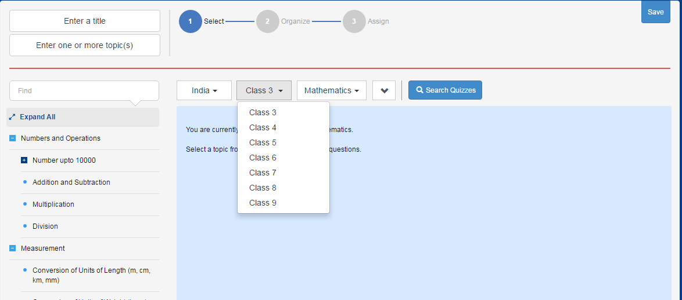
How to create assignment? - Quiz
Country/Level can be selected here
Provide keywords to search
Search for Pre-created quizzes for a particular topic
Click to view the topics and questions

Slide 10
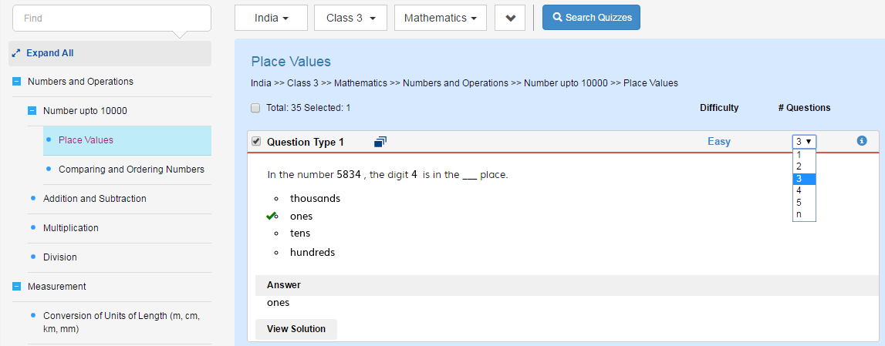
How to create assignment - Quiz
Select to add question types
Click a topic to view/select questions
Set the number of questions

Slide 11
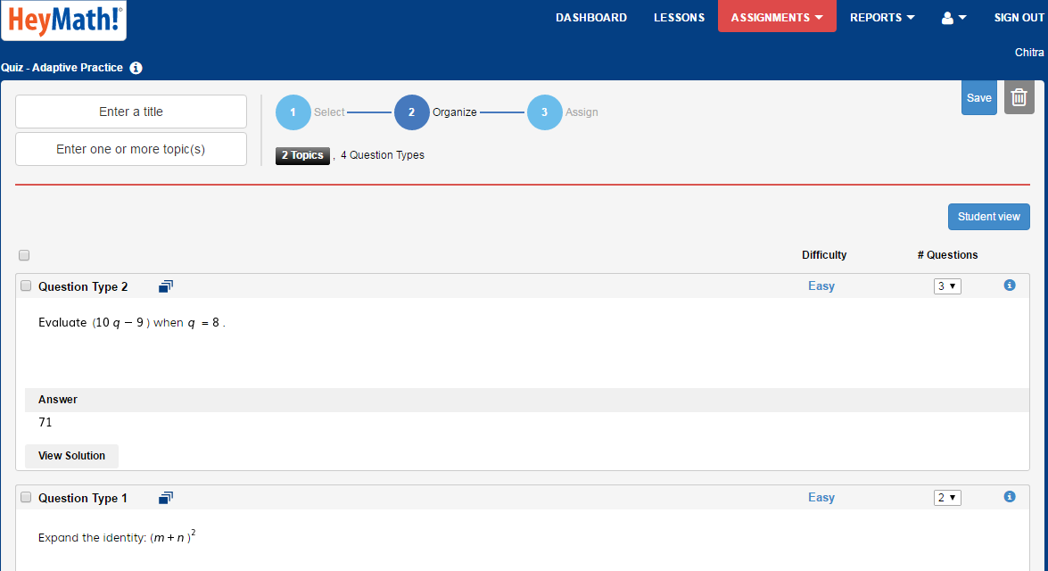
How to create assignment - Quiz
Click to save the order of questions
Step 2
Click to delete assignment
Enter the Title/Topic
Click to preview the questions in student view
You can re-arrange the questions by drag & drop

Slide 12
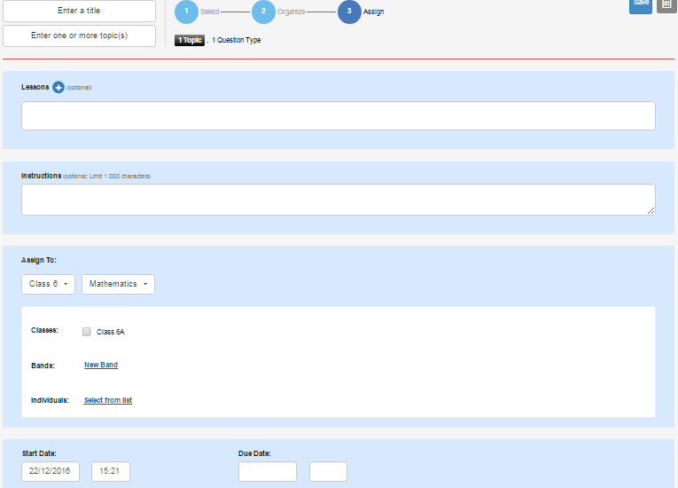
How to create assignment - Quiz
Step 3
Click here to add reading lessons
Provide instructions for students
Select the Level & Subject
Select class/Bands/Individuals to assign quiz
Set the Start & Due dates

Slide 13
How to create assignment - Worksheet
Click to create worksheet

Slide 14
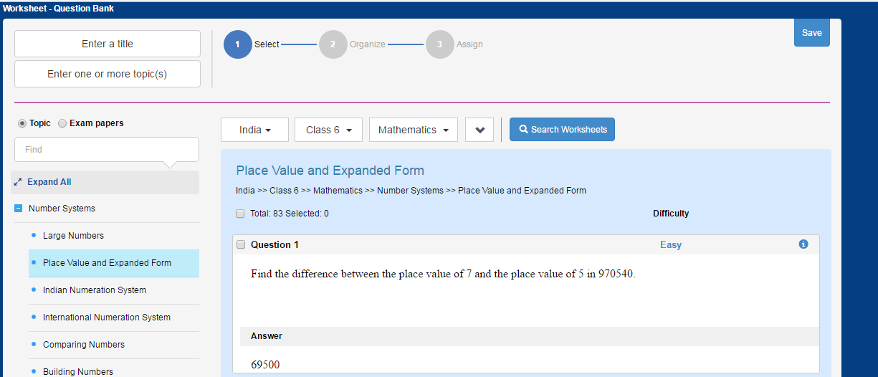
How to create assignment - Worksheet
Questions can be filtered based on Topics / Exam Papers
Select the Level
Click to select a question
Click to see the questions

Slide 15
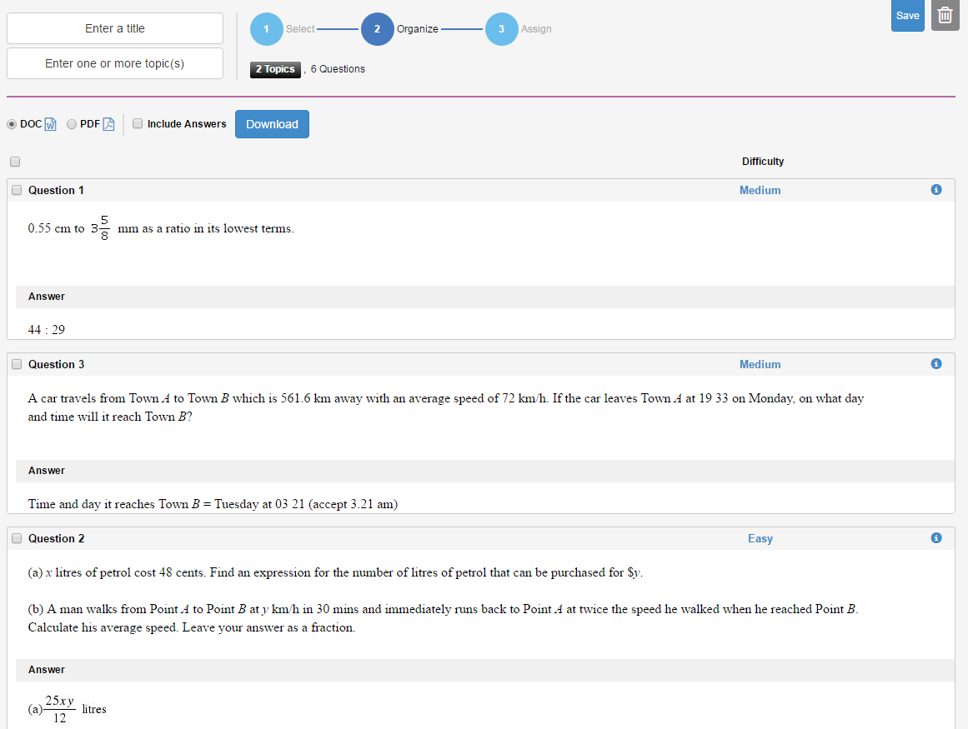
How to create assignment - Worksheet
Click to Save your worksheet in Drafts and continue later
Step 2
Click to delete the worksheet
Click to download your worksheet
Select doc/pdf

Slide 16
How to create assignment - PRASSO
Click PRASSO to assign topics to students
Click Start to select & assign
Click to see the Prasso reports
Click to see the recommendation Log
Click to Student view
Click on a topic to view the question types

Slide 17
How to create assignment - PRASSO
Click on Proceed to select the classes
Select the level & Class
Click on Assign to send it to your students

Slide 18
Reports
Click on Reports to view teachers/students usage
Reports –
The teacher can see the login/lessons accessed/assignments issued of self as well as of other teachers in the school
The teacher can see the login/lessons accessed/assignments accessed (or) submitted by students

Slide 19
Reports - Teachers
Click on Logins / Lessons Accessed / Assignments Assigned to view the relevant data
Select the dates to retrieve the usage for a period of time.
Click to view graphic representation
Customise your table by removing column heads
Click to export the report

Slide 20
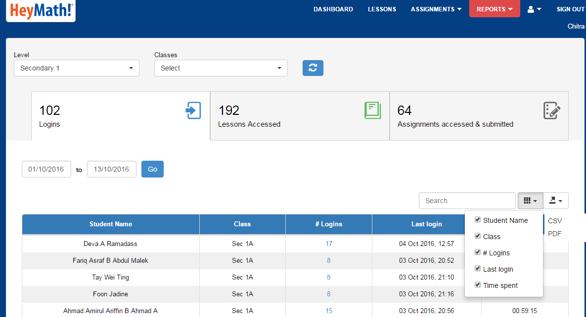
Reports - Students
Select the Level & Class
Click on Logins / Lessons Accessed / Assignments Assigned to view the relevant data
Click here to export the report
Customise your table by removing column heads

Slide 21
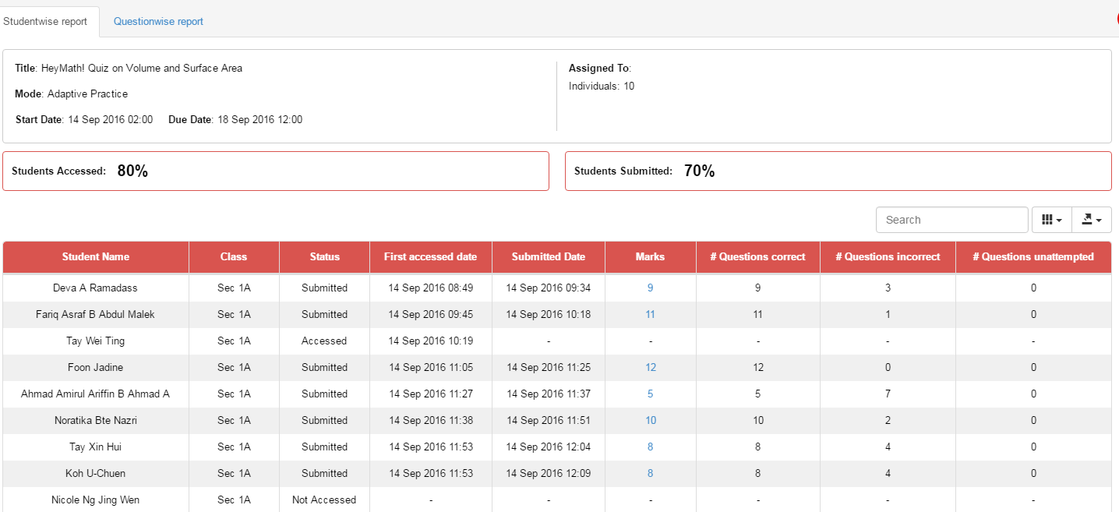
Assignment Reports
Click to view the question wise report

Slide 22
Edit Profile
Click to update your profile / Contact us
You can change your password here and update a valid email address
Teachers can reset the password for students by clicking here

Slide 23
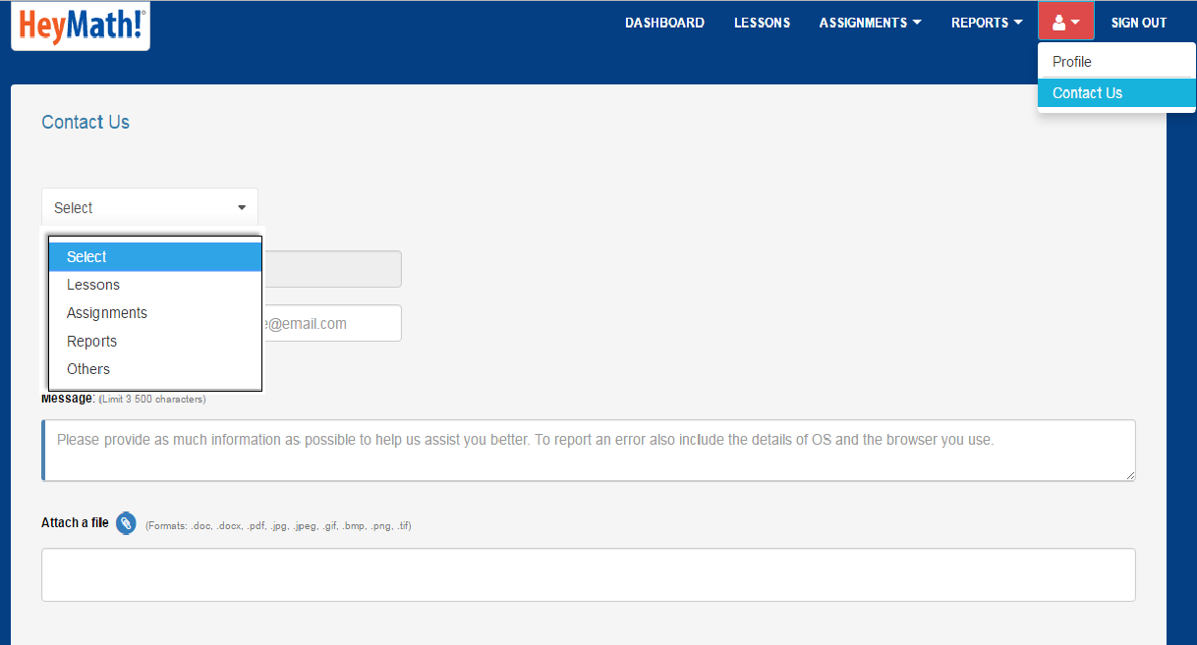
Contact Us
Click Contact Us to send a message to HeyMath!
Select the nature of the query
Type in your message
Use this to attach files / screenshots
Please note that you will receive a reply only if your email ID is a valid one.
Click to send your message. HeyMath! Support team will revert to you at the earliest

Slide 24
Thank You

